Slide 1
GraphQL with React
Daniel Zen
@danielzen @zendigital
training@zen.digital
© 2019 zen.digital

Slide 2

My Background
Systems Architect, Developer & Trainer
Extensive Engineering & Agile/XP Background
MIT, Google, Pivotal Labs
Started AngularNYC Meetup 2012
Founder of zen.digital
Enterprise Training
Consulting & Best Practices
Team Augmentation
Full Stack JavaScript & Java
DevOps, CI/CD & Testing Practices
Mobile Solutions

Slide 3
Tell me a little bit about yourself …
Are you all JavaScript developers?
http://zen.digital/javascript/quiz
Any designers?
Managers?
What types of industry?
Anything else you would like me to know?

Slide 4
What is GraphQL
A query language for APIs and a runtime for fulfilling those queries with your existing data
Response to modern web application needs
Alternative to REST
Developed internally by Facebook in 2012
Released publicly in 2015
Specification
https://graphql.github.io/graphql-spec/June2018/
https://github.com/graphql/graphql-spec

Slide 5
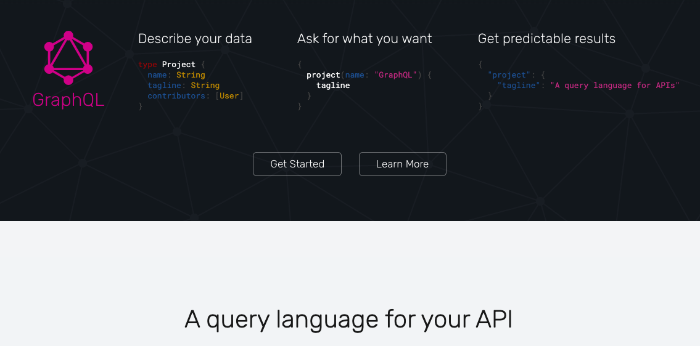

Slide 6
Who is using GraphQL
AirBnb
Coursera
Facebook
GitHub
Intuit
Meteor
New York Times
Pinterest
Shopify
Spotify
Ticketmaster
Twitter
Yelp
You?

Slide 7
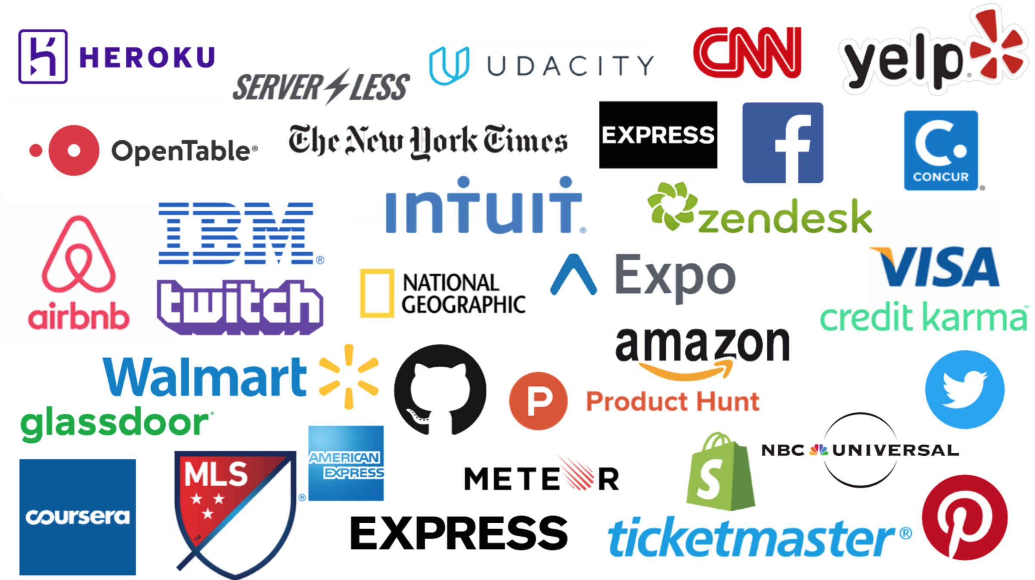

Slide 8
Why did Facebook create GraphQL
Invented during the move from HTML5 to native
Problems encountered using REST
Hierarchical - Multiple round trips may overload the network (mobile)
REST Client depends on server - breaking changes
GraphQL is strongly-typed
Introspection
Notes:
Type has fields. Allows for descriptive error messages.
Strong typing & Introspection allow for code generation. You can explor/query your API

Slide 9
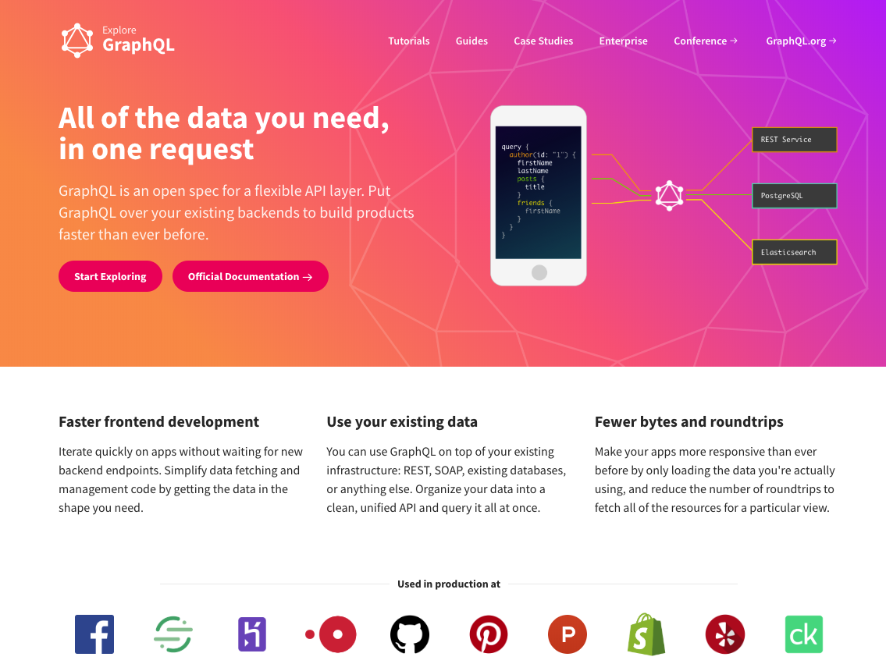

Slide 10



GraphQL creators
Lee Byron
@leeb
Nick Schrock
@schrockn
Dan Schafer
@dlschafer

Slide 11
GraphQL Timeline
2012 - GraphQL created at Facebook
2013 - React is released
2014 - React Native is released
2015 - GraphQL is open sourced
- Relay Classic is open sourced
2016 - GitHub announces GraphQL API
- New GraphQL website graphql.org
- First GraphQL Summit

Slide 12
GraphQL Timeline (cont)
2017 - Apollo Client 1.0
- Relay Modern 1.0
- Apollo Client 2.0
2018 - Prisma 1.0
- Apollo Engine
2019 - Apollo Client 2.5

Slide 13
GraphQL Backend Servers
Node middleware libraries
Express
Hapi
Koa
GraphQL Baas
Graphcool / Prisma
Scaphold
Hasura
PostGraphile (for PostgreSQL)
json-graphql-server

Slide 14










Implementations

Slide 15

Query Language
// GET '/graphql'
allTodoes(first: 1) {
complete
text
}
Query has same shape as result
Check out the following page
https://graphql.github.io/learn/
// result
{
"data": {
"allTodoes": [
{
"complete": true,
"text": "Learn GraphQL"
}
]
}
}

Slide 16
Common Persistence Practices
CRUD - Create, read, update and delete
Each letter in the acronym can map to a standard SQL statement and HTTP method:
Operation` | SQL | HTTP (REST)
Create | INSERT | PUT / POST
Read (Retrieve) | SELECT | GET
Update (Modify) | UPDATE | PUT / PATCH
Delete (Destroy) | DELETE | DELETE
Notes:
The term CRUD was likely first popularized by James Martin in his 1983 book Managing the Data-base Environment.

Slide 17
Typically we employed CRUD via RESTful APIs
RESTful APIs - Representational state transfer
The name “Representational State Transfer” is intended to evoke an image of how a well-designed Web application behaves: a network of Web pages forms a virtual state machine, allowing a user to progress through the application by selecting a link or submitting a short data-entry form, with each action resulting in a transition to the next state of the application by transferring a representation of that state to the user. - Roy Fielding
HTTP 1.1 based on REST
Notes:
The term representational state transfer was introduced and defined in 2000 by Roy Fielding in his doctoral dissertation atUC Irvine.^{[1][3]}

Slide 18
Common REST Practices
Resource | POST create` | GET read | PUT update | DELETE delete
/accounts | Create a new account | List accounts | Bulk update accounts | Delete all accounts
/accounts/123 | Error | Show account 123 | If exists update account 123 If not error | Delete account 123
/customers | Create a new customer | List customers | Bulk update customers | Delete all customers
/customers/456 | Error | Show customer 456 | If exists update customer 456 If not error | Delete customer 456
Notes:
The term CRUD was likely first popularized by James Martin in his 1983 book Managing the Data-base Environment.

Slide 19
REST isn't a fit for modern applications
The point-to-point nature of REST, a procedural API technology, forces the authors of services and clients to coordinate each use case ahead of time. When frontend teams must constantly ask backend teams for new endpoints, often with each new screen in an app, development is dramatically slowed down. Both teams need to move fast independently.

Slide 20
A data graph at the center of your architecture
GraphQL decouples apps from services by introducing a flexible query language. Instead of a custom API for each screen, app developers describe the data they need, service developers describe what they can supply, and GraphQL automatically matches the two together. Teams ship faster across more platforms, with new levels of visibility and control over how their data is used.

Slide 21
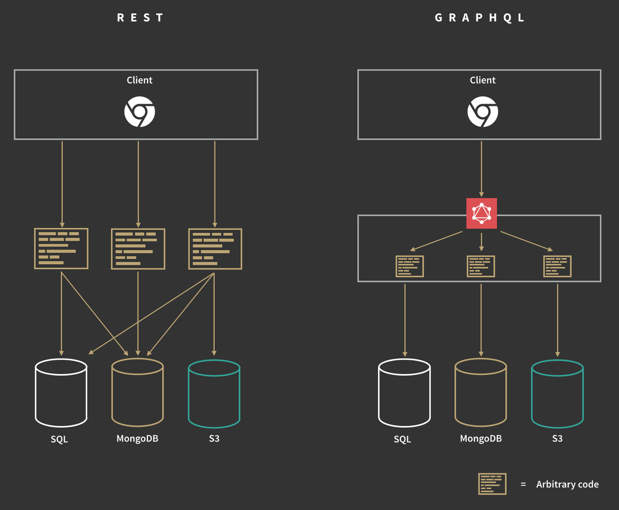
Overview:
GraphQL replaces REST “best practices” with a clear & simple structure

Slide 22
Why use GraphQL

Slide 23
Some reasons
Declarative
Decoupled from storage
Validated and structured
Facilitates Collaboration
Super fast

Slide 24



GraphQL Clients
Apollo Client
Relay Modern
urql

Slide 25
Tools

Slide 26
GraphQL Playground (server GUI from Prisma)
All GraphiQL features (original GUI from GraphQL/FB)
Standalone App available
Multi-server (endpoint per tab)
Prettify, History, HTTP Headers
Supports real-time subscriptions and tracing (Apollo)
Standalone App

Slide 27
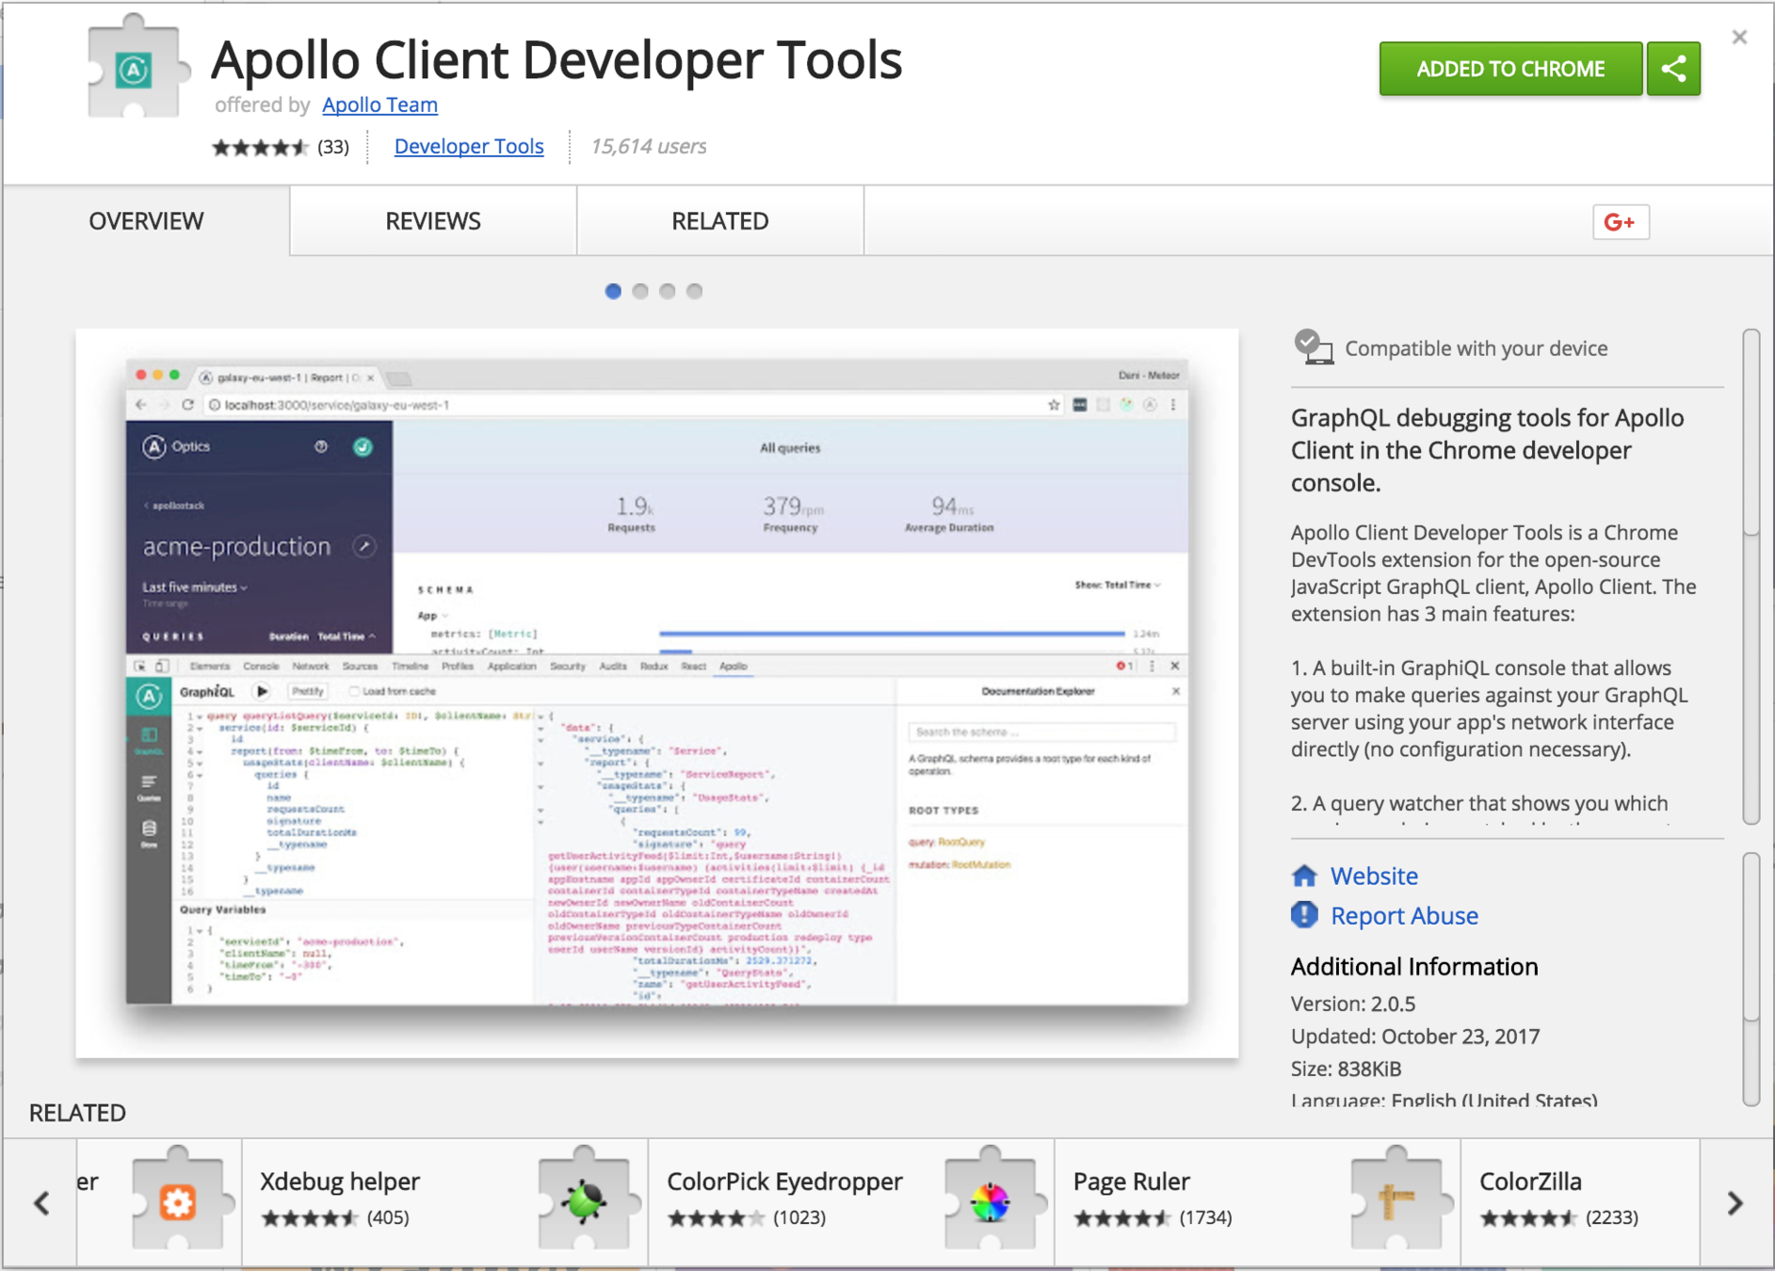
Apollo Client Developer Tools

Slide 28
Newish Dev Tools Stuff (over a year old now)
Newer Architecture
​ Stability and performance
Apollo Client 2.x (2.5)
Apollo Link
Apollo Link State

Slide 29
Don't Versioning - Evolve your API
While there's nothing that prevents a GraphQL service from being versioned just like any other REST API, GraphQL takes a strong opinion on avoiding versioning by providing the tools for the continuous evolution of a GraphQL schema.
Why do most APIs version? When there's limited control over the data that's returned from an API endpoint, any change can be considered a breaking change, and breaking changes require a new version. If adding new features to an API requires a new version, then a tradeoff emerges between releasing often and having many incremental versions versus the understandability and maintainability of the API.
In contrast, GraphQL only returns the data that's explicitly requested, so new capabilities can be added via new types and new fields on those types without creating a breaking change. This has led to a common practice of always avoiding breaking changes and serving a versionless API.

Slide 30
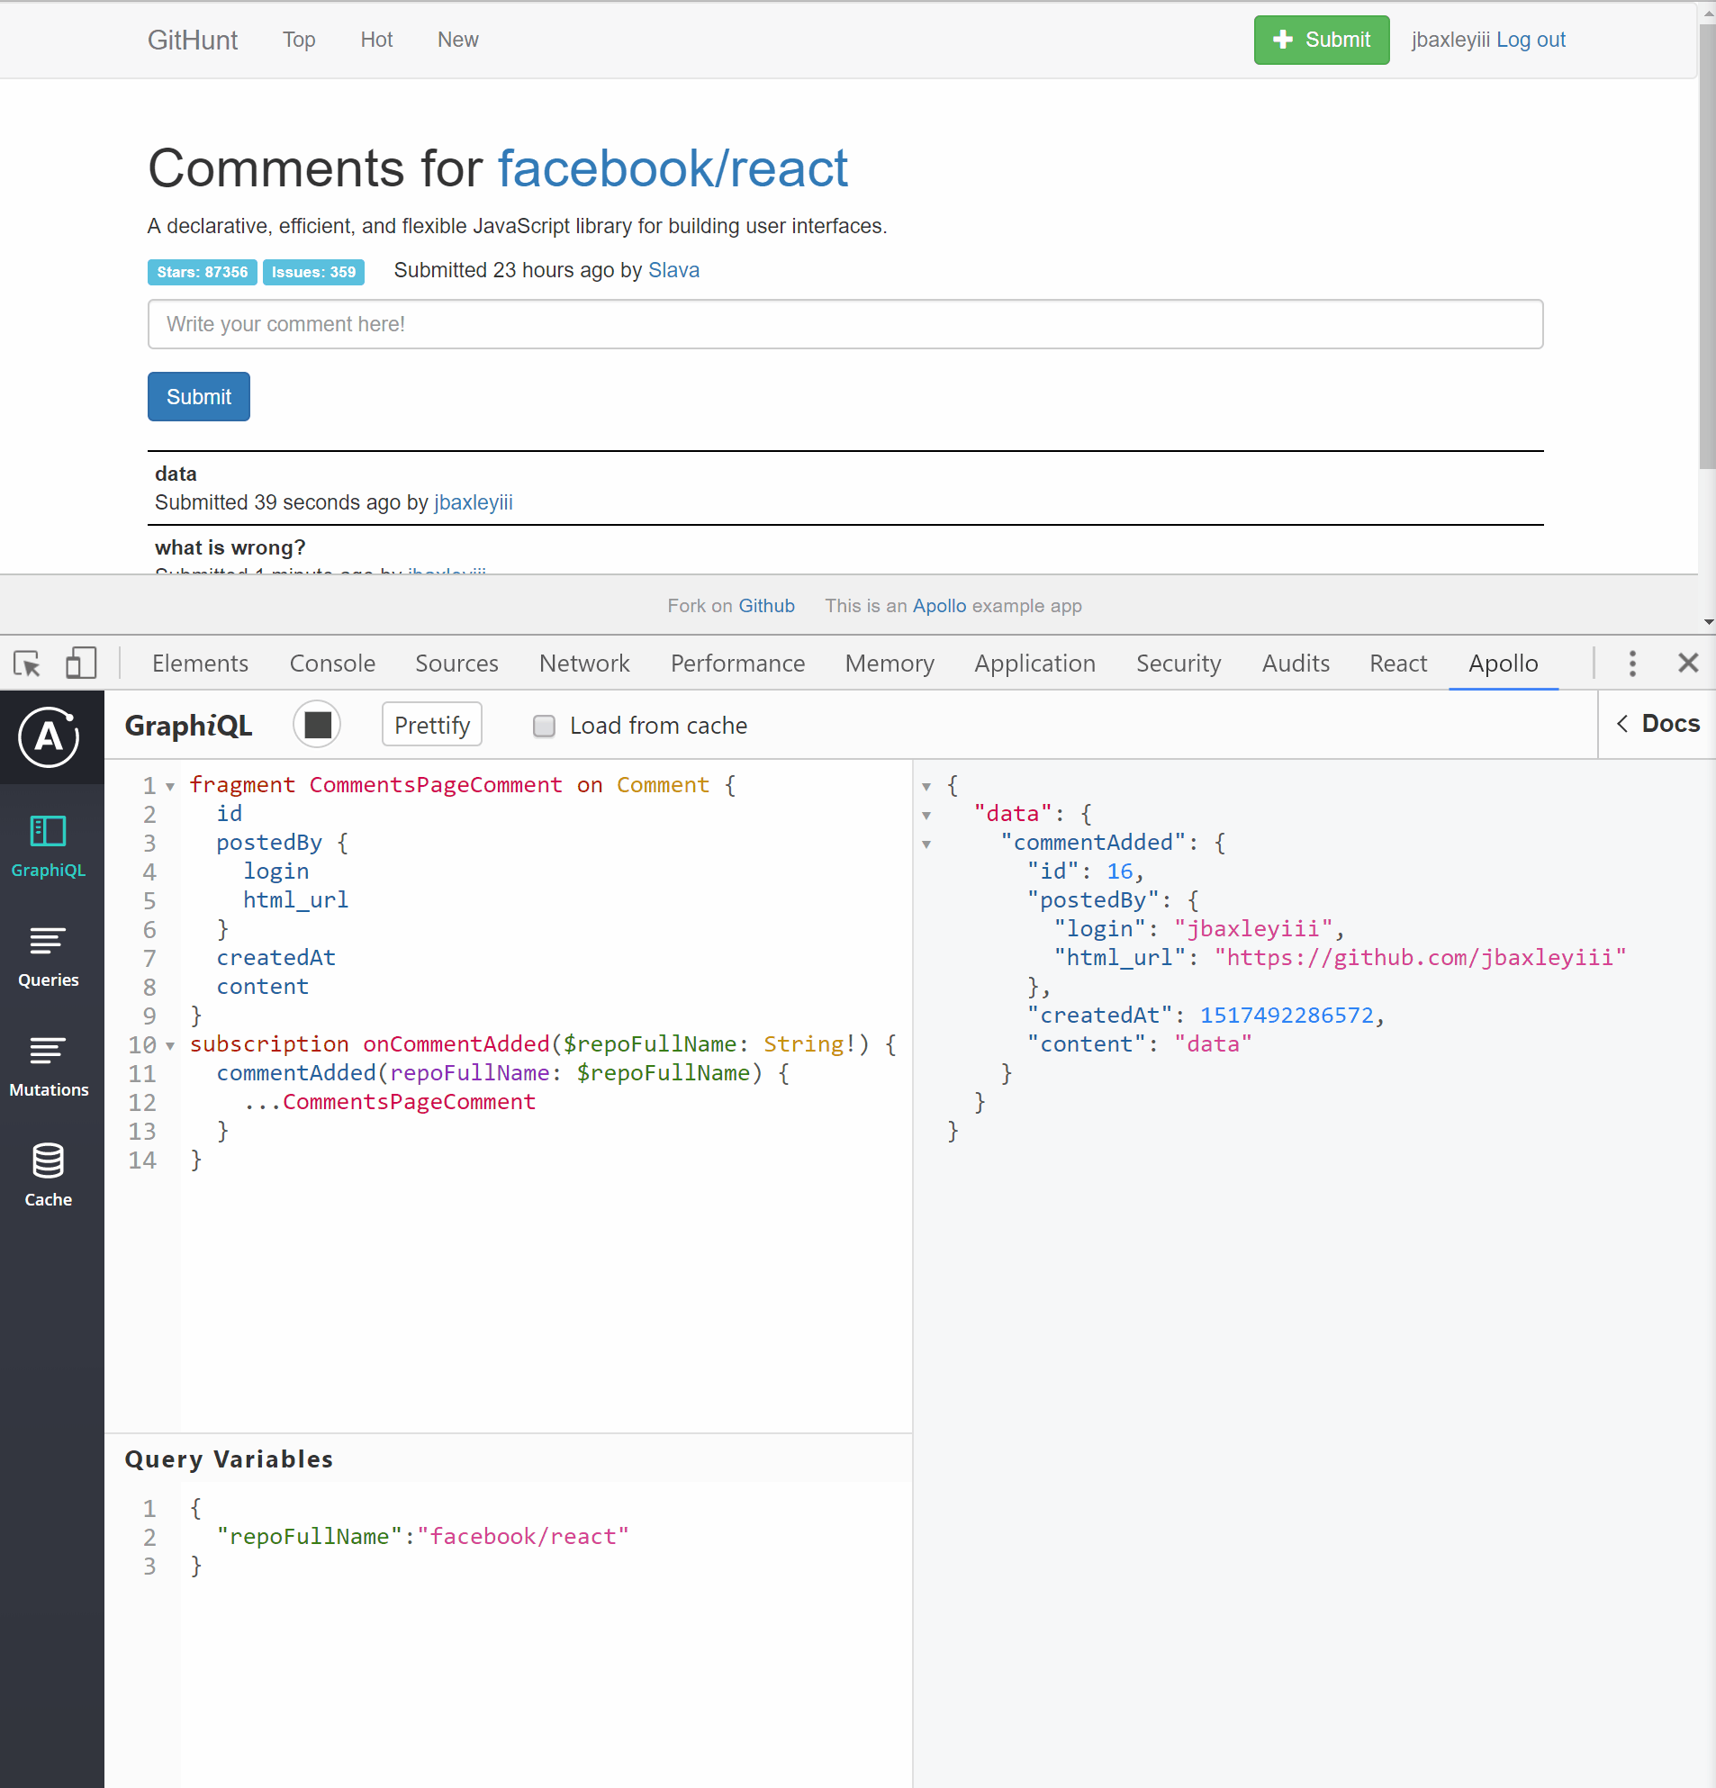
Subscription Support

Slide 31
Relay Modern

Slide 32
Relay Modern
Relay is Facebook’s homegrown GraphQL client that they open-sourced alongside GraphQL in 2015. It incorporates all the learnings that Facebook gathered since they started using GraphQL in 2012. Relay is heavily optimized for performance and tries to reduce network traffic where possible. An interesting side-note is that Relay itself actually started out as a routing framework that eventually got combined with data loading responsibilities. It thus evolved into a powerful data management solution that can be used in Javascript apps to interface with GraphQL APIs.

Slide 33
Relay Modern Overview
Maintained by Facebook
Latest release: v5
View-agnostic runtime
Integrations: React
GitHub: Over 13K stars
MIT license

Slide 34
Relay Main Features
Focused on Performance
Relay compiler/babel plugin
Optimisations
Facebook abstractions
Colocation
Custom Store
Connection, Records, Fields
Viewer, Pagination

Slide 35
Apollo Client

Slide 36
Apollo Client
Apollo Client is a community-driven effort to build an easy-to-understand, flexible and powerful GraphQL client. Apollo has the ambition to build one library for every major development platform that people use to build web and mobile applications. Right now there is a Javascript client with bindings for popular frameworks like React, Angular, Ember or Vue as well as early versions of iOS and Android clients. Apollo is production-ready and has handy features like caching, optimistic UI, subscription support and many mor

Slide 37
Apollo Client Overview
Maintained by Meteor
Latest release: 2.6.3
Integrations: React, Angular, Vue
GitHub: Over 11.5K stars
MIT license

Slide 38
Apollo Client Features
Community driven
Simplicity
Integration with multiple frameworks

Slide 39
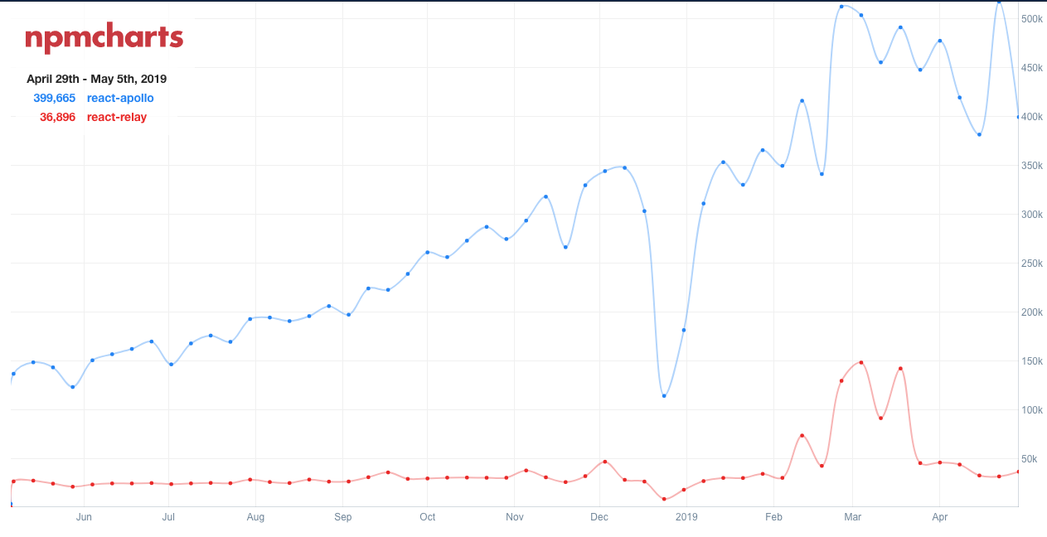
Relay vs Apollo Downloads

Slide 40


CLIENT
SERVER
React
Relay
Modern
Apollo
Client
GraphCool

Slide 41

CLIENT
SERVER
Angular
Apollo
Client
GraphCool

Slide 42
Setup
Relay compiler/ Babel plugin
Environment
Network
Store
Via attribute
Loader graphql-tag
ApolloClient
Apollo Link
Apollo Cache
ApolloProvider HOC

Slide 43
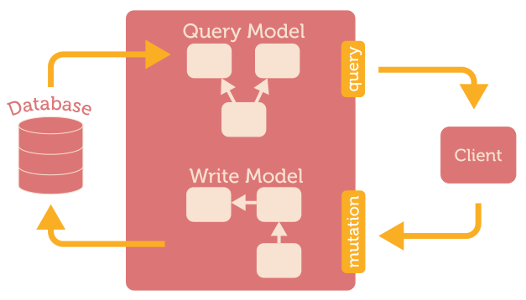
Queries
source: gist

Slide 44
Queries
QueryRenderer
Environment
Query
Queries generation
Automated
Opinionated
graphql HOC
Queries generation
Manual
Flexible

Slide 45
Mutations
source: gist

Slide 46
Mutations
Apollo considered better at mutations
commitMutation
Environment
Update Store via
Connection
Fields/LinkedRecord
Optimistic Updates
Added via props
graphql HOC/mutate
Update Store via Cache/arguments
Optimistic Updates

Slide 47
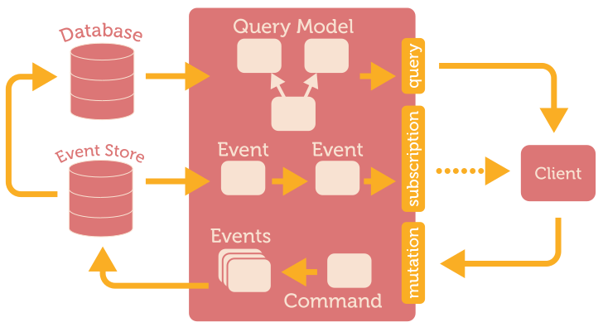
Subscriptions
source: gist

Slide 48
Subscriptions
requestSubscription
Environment
Update Store via
Connection
Fields/LinkedRecord
subscribeToMore
Update Store via reducer/arguments

Slide 49
Summary
Awesome option
Familiar with Facebook-way
Viewer/Connector
Pagination
Schema with lots of fragments
Awesome option
May need other Frameworks
Modular design
Less concepts to learn

Slide 50
GraphQL service
Define types (User) and fields on types (id, name, dateOfBirth)
type User @model {
id: ID! @isUnique
name: String
dateOfBirth: DateTime
}
@model are top-level entities in the generated API
@isUnique are unique elements
ID! The ! means this is a required/non-nullable field

Slide 51
Graphcool Lab

Slide 52
Graphcool Framework (LAB)
provides a production-ready GraphQL API out-of-the-box
Open-source and self-hosted backend-as-a-service
Develop serverless GraphQL backends
Offers an opinionated backend setup, including:
GraphQL database mapping
subscriptions
permission system.
npm install -g graphcool

Slide 53
Graphcool Lab continued
Open a terminal and and type:
graphcool init server
This will create a new server directory with the following files:
graphcool.yml - root configuration file for your Graphcool service.
types.graphql - data model for your application (GraphQL SDL)
package.json - npm dependencies
src - code of the serverless functions for Graphcool service

Slide 54
Graphcool Deploy
navigate into the server directory
graphcool deploy --force
When prompted, select any of the Shared Clusters deployment options, e.g. shared-us-west-2.
For any other prompt, you can just hit Enter to go with the suggested default value.
Note that this command will open up a browser window first and ask you to authenticate on the Graphcool platform (if you haven’t done so before).

Slide 55
GraphQL Schema

Slide 56
Schema Overview
Entry points
Query
Mutation
Subscription
Features
Validation, Documentation and Introspection

Slide 57
Type System
Scalar Types:
Int
Float
String
Boolean
ID
Object Types:
Post

Slide 58
Schema Syntax
Mandatory: String!, Post!
Optional: String, Post
Lists: [String], [Post]

Slide 59
GraphQL Schema for ToDo app 👁
schema {
query: Query
mutation: Mutation
subscription: Subscription
}
type Query {
allTodoes(first: Int): [Todo]
}
type Todo {
id: ID!
text: String!
complete: Boolean!
}
Playground
allTodoes(last: 2) {
id, text, complete
}
}
with alias:
todos: allTodoes(last: 2) {
id, text, complete
}
}

Slide 60

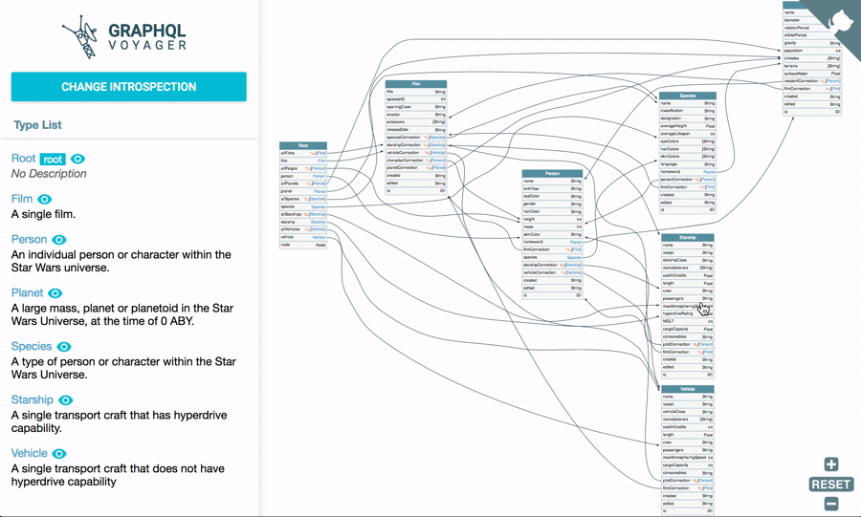
apis-guru/graphql-voyager

Slide 61
Download and install a local copy of swapi-graphql
The Star Wars API was often used for REST examples
The GraphQL version can be run locally
It has the GraphiQL UI built in (not the Playground ):
git clone https://github.com/graphql/swapi-graphql.git
cd swapi-graphql
npm start
{ allFilms {
films {
title
}
}}

Slide 62
Query Syntax

Slide 63
Quick ApolloClient Lab
Let's go over the Get started for Apollo at:
https://www.apollographql.com/docs/react/essentials/get-started/
This is a very quick lab that will show you how little it takes to get up and running with ApolloClient.
We will be connecting to an Exchange Rate GraphQl service at:
https://48p1r2roz4.sse.codesandbox.io
{
rates(currency: "USD") {
currency
}
}

Slide 64
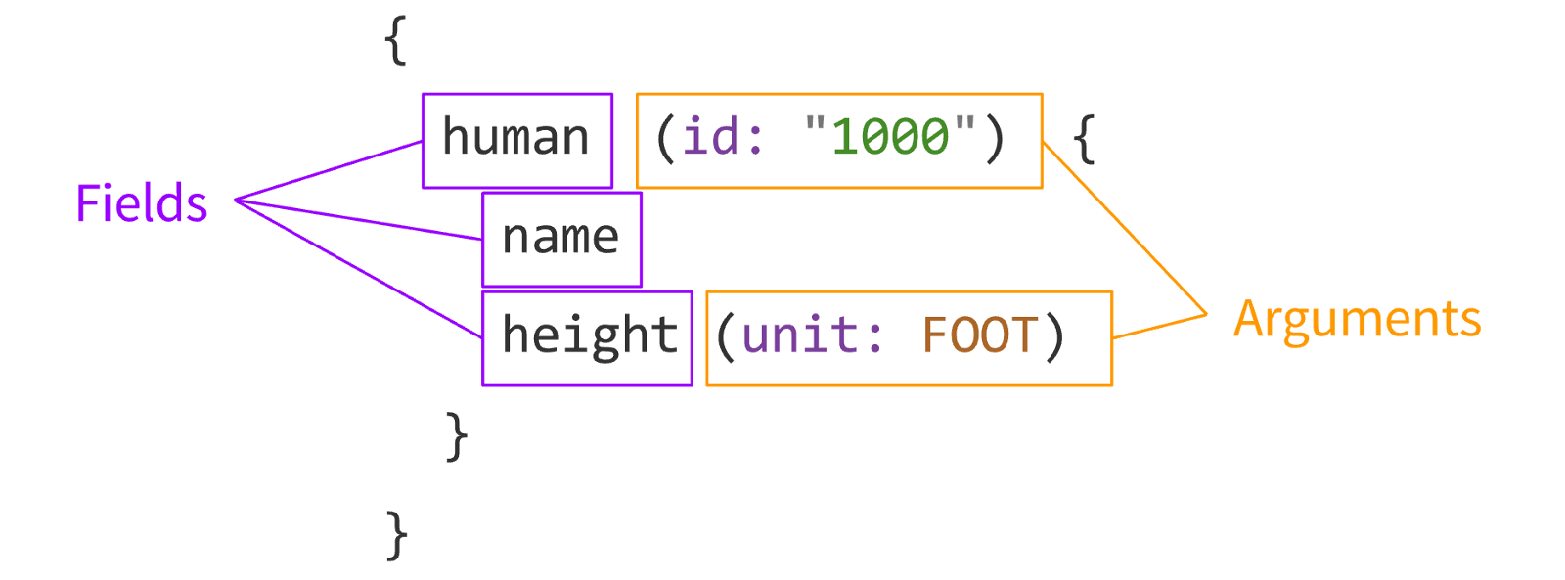
Anonymous Query
Example from: https://graphql.org/learn/queries/

Slide 65
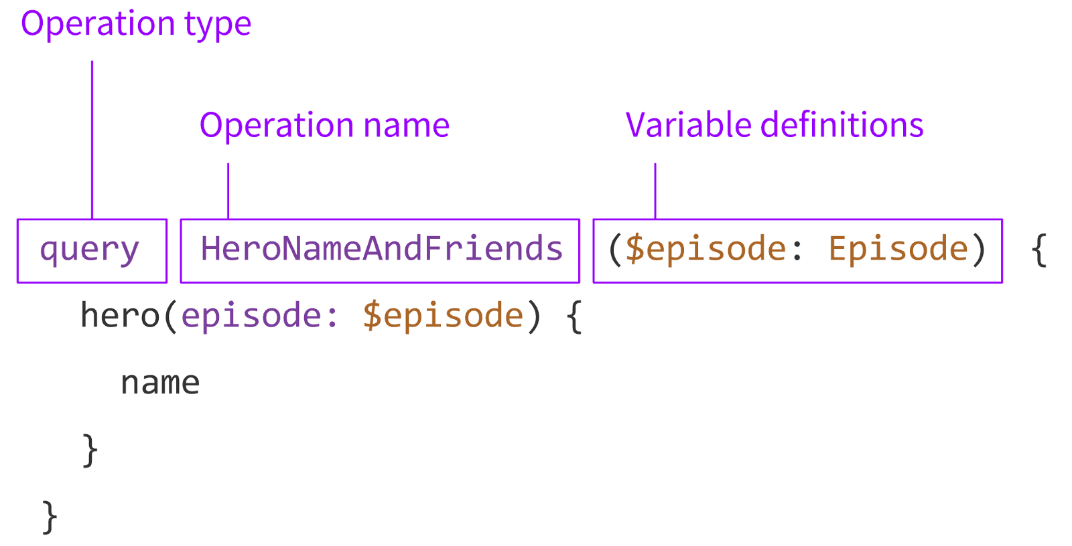
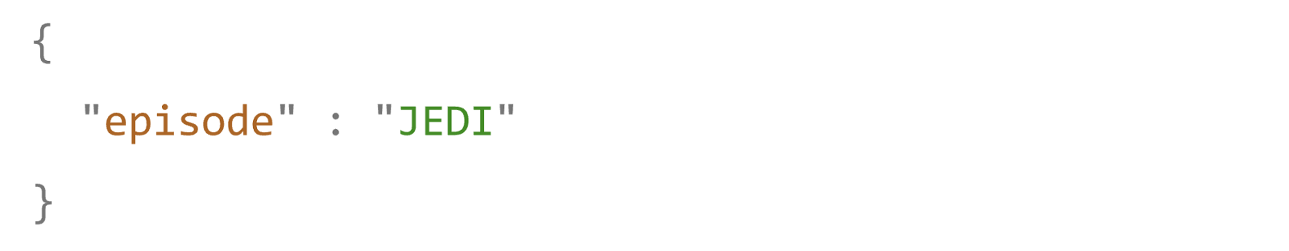
Named Query
Query Variables:

Slide 66
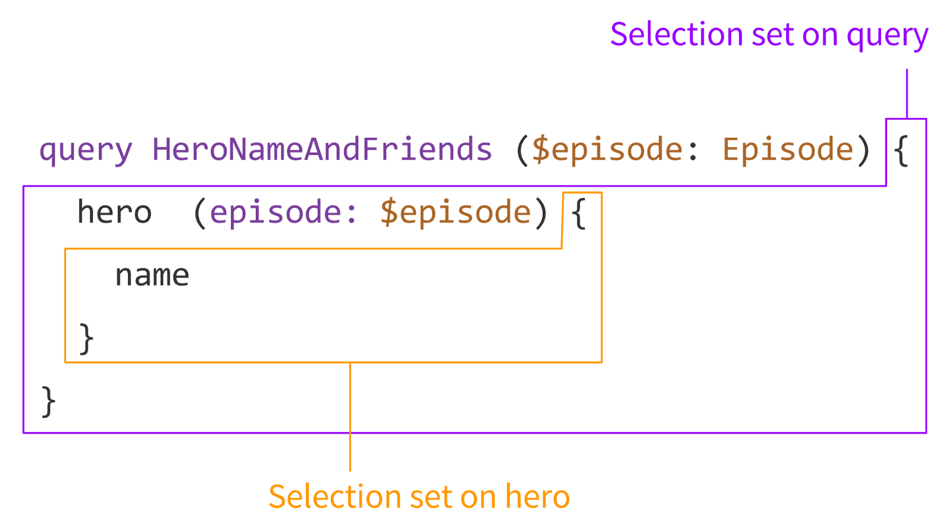
Selection Sets

Slide 67
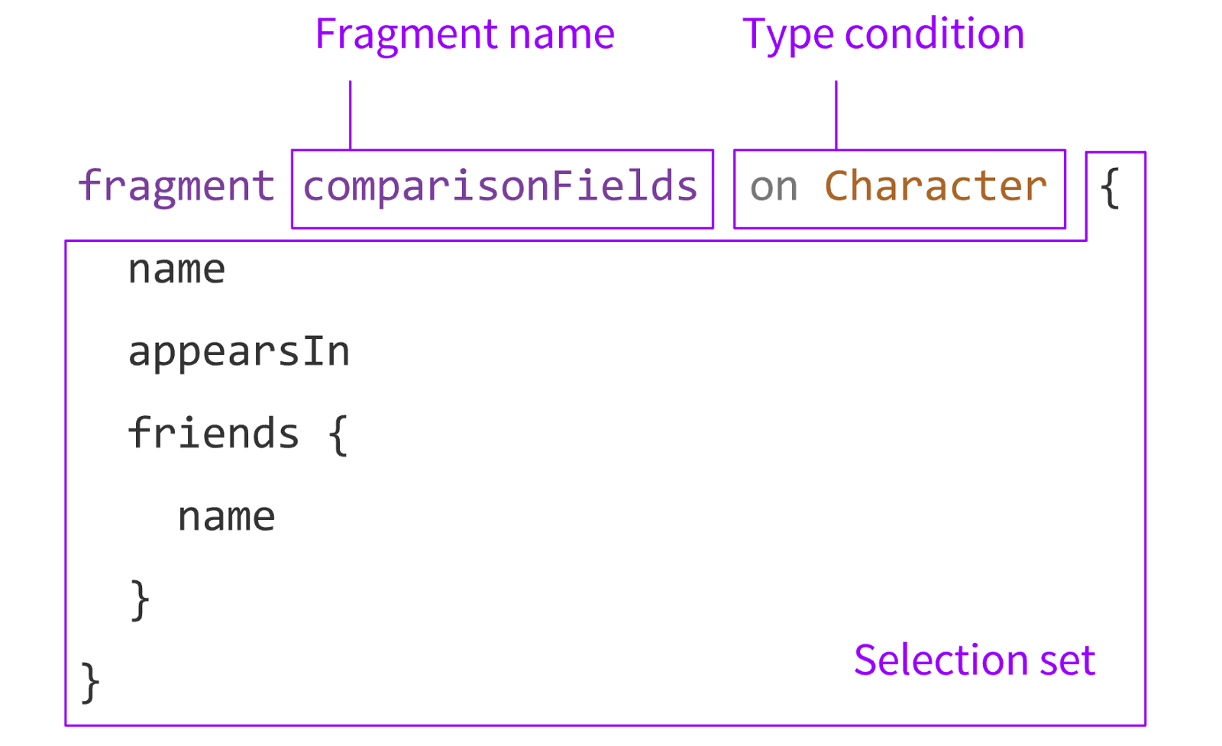
Fragments

Slide 68
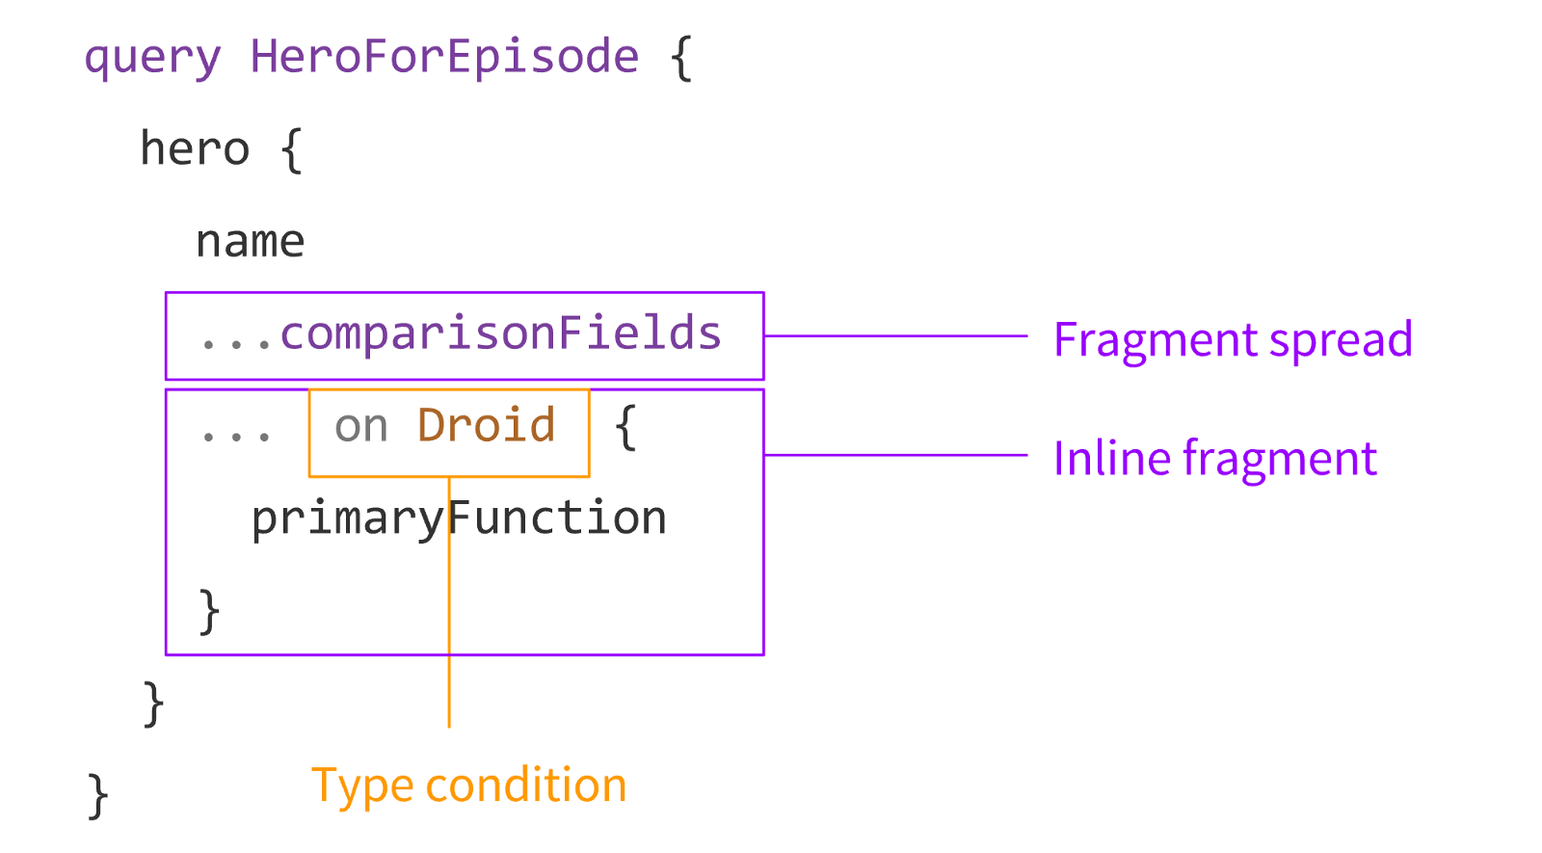
Using Fragments

Slide 69
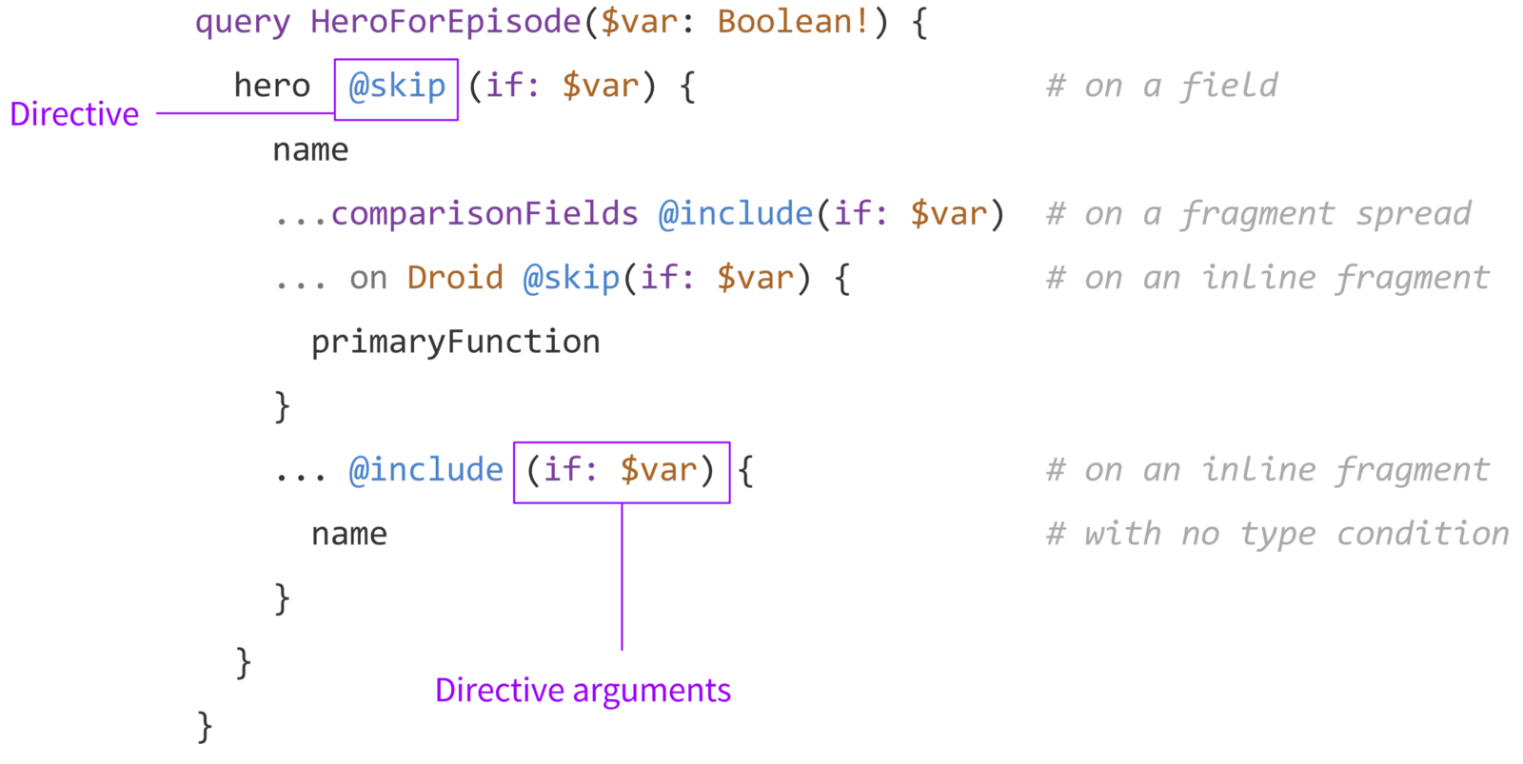
Directives

Slide 70

Exercises

Slide 71
Graphcool Lab

Slide 72
Todo App

Slide 73
Todo Schema
project.graphcool
schema {
query: Query
mutation: Mutation
subscription: Subscription
}
type Query {
allTodoes(first: Int): [Todo]
}
type Todo @model {
id: ID! @isUnique
text: String!
complete: Boolean!
}

Slide 74
demo

Slide 75
Apollo Client
Apollo
Cache
Apollo
Link

Slide 76
Apollo Cache

Slide 77
Apollo Cache Packages
apollo-cache-inmemory
apollo-cache-hermes
apollo-cache-persist

Slide 78
InMemoryCache
Normalised and flattened
this.props.client.cache
readQuery, writeQuery
readFragment, writeFragment

Slide 79
Apollo Cache Example
Query
Result
query todos {
allTodoes {
id
text
complete
__typename
}
}
{
"data": {
"allTodoes": [
{
"id": "1",
"text": "Learn GraphQL 📚",
"complete": false,
"__typename": 'Todo',
},
{
"id": "2",
"text": "Learn Apollo Client ✨👨‍🚀",
"complete": true,
"__typename": 'Todo',
}]
}

Slide 80
Normalised and flattened
{
ROOT_QUERY: {
allTodoes: ['Todo:1', 'Todo:2'],
},
'Todo:1': {
id: '1',
text: 'Learn GraphQL 📚',
completed: false
},
'Todo:2': {
id: '2',
text: 'Learn Apollo Client ✨👨‍🚀',
completed: false
}
}
read/writeQuery
__typename:id
read/writeFragment

Slide 81
Retrieving todos from cache
const query = gql`query AllTodos {
allTodoes { id text complete }
}`;
const data = store.readQuery({ query });
const newTodo = {
id: createTodo.id,
text: input.value,
complete: false,
__typename: "Todo"
};
store.writeQuery({
query,
data: {
allTodoes: [...data.allTodoes, newTodo],
},
});

Slide 82
Set security headers
import ApolloClient from 'apollo-boost';
const client = new ApolloClient({
uri: 'https://your-server/graphql',
request: operation => {
operation.setContext(context => ({
headers: {
...context.headers,
authorization: localStorage.getItem('authtoken')
}
}))
}
});

Slide 83
GraphQL Server

Slide 84
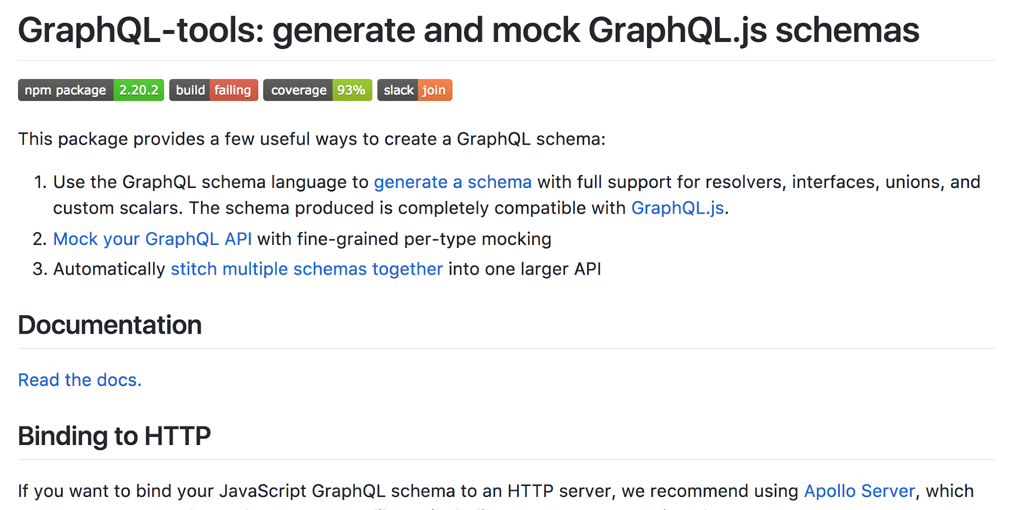
apollographql/graphql-tools

Slide 85
graphql-tools
Runtime Schema:
resolvers
interfaces
unions
custom scalars
Allows mocking types

Slide 86
Schema
const typeDefs = `
type Post {
title: String
}
type Query {
posts: [Post]
}
type Mutation {
upvotePost (postId: ID!): Post
}
schema {
query: Query
mutation: Mutation
}`;

Slide 87
Resolvers
const resolvers = {
Query: {
posts() {
return posts;
},
},
Mutation: {
upvotePost(_, { postId }) {
const post = find(posts, { id: postId });
post.votes += 1;
return post;
},
},
};

Slide 88
makeExecutableSchema
import { makeExecutableSchema } from 'graphql-tools';
const executableSchema = makeExecutableSchema({
typeDefs,
resolvers,
});

Slide 89
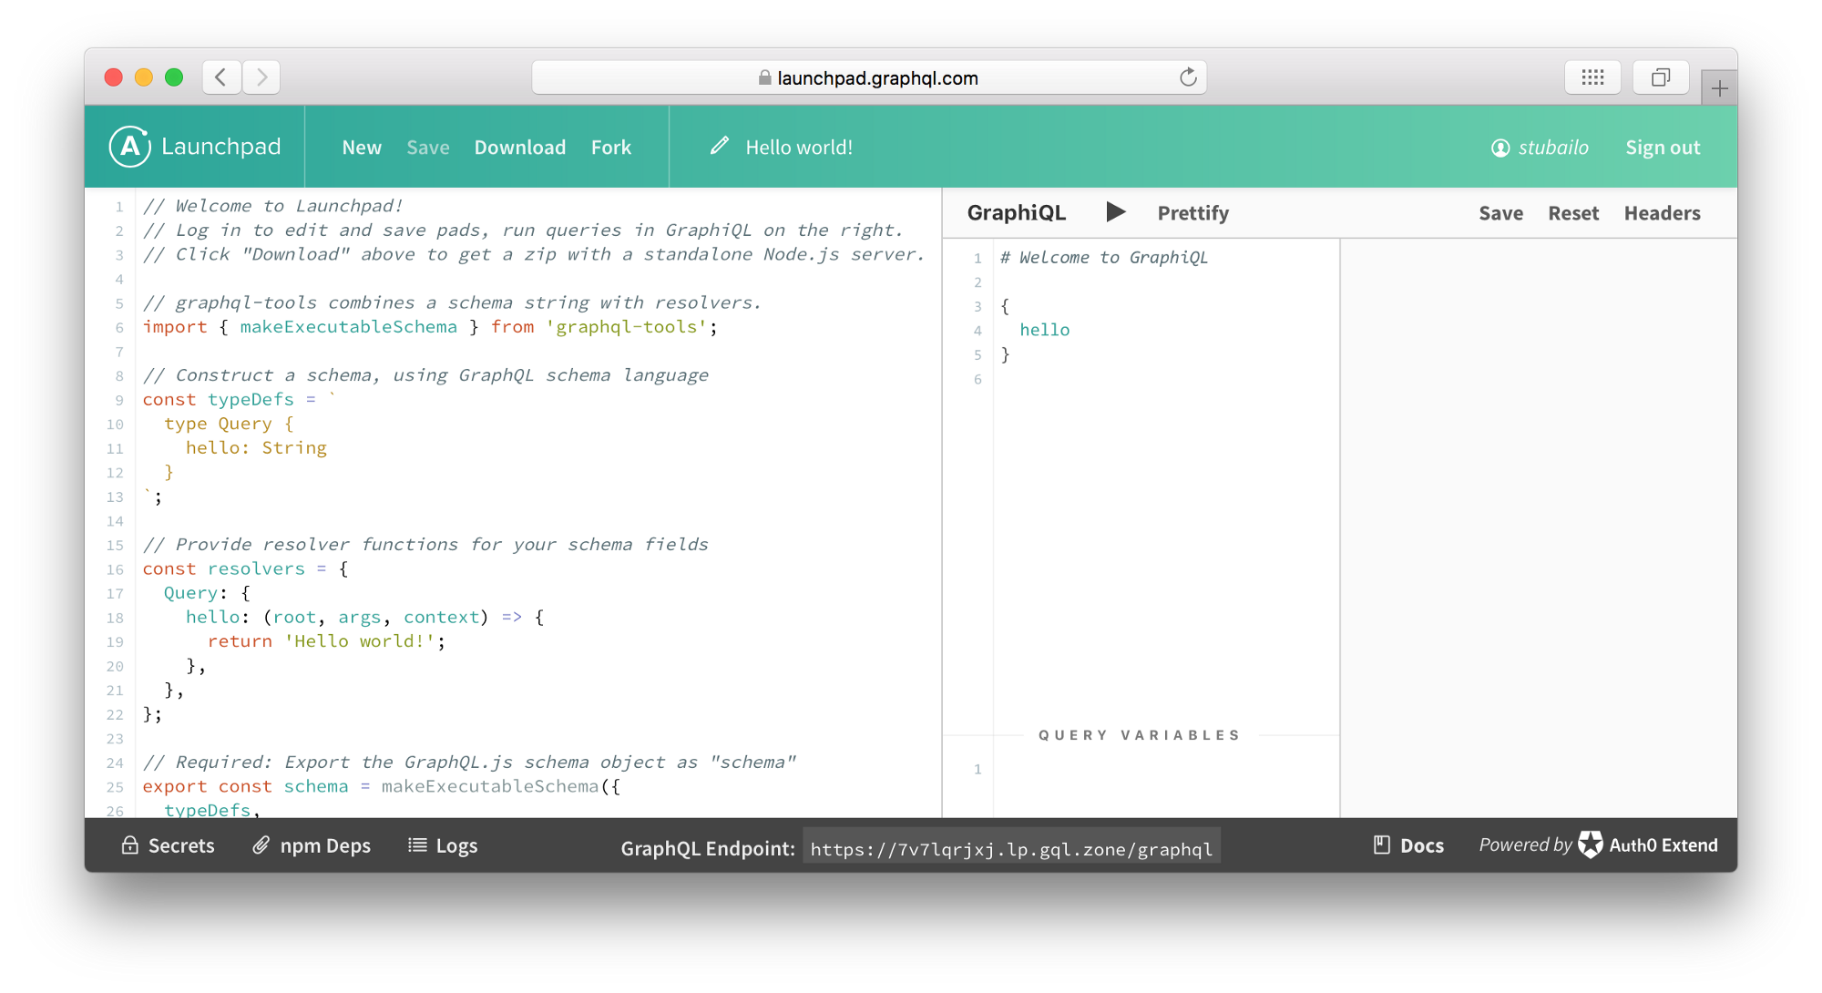
launchpad.graphql.com - Still works for now

Slide 90
Check out Launchpad Running at:
https://codesandbox.io/s/apollo-server
https://glitch.com/~apollo-launchpad

Slide 91
Resolvers
Each field in a GraphQL schema is backed by a resolver
Resolver parameters
root/parent, result previous call
args, query parameters
context, share information
info, query AST

Slide 92
Resolvers Example
const resolvers = {
Query: {
feed(parent, args, ctx, info) {
return ctx.db.query.posts({ where: { isPublished: true } }, info)
},
drafts(parent, args, ctx, info) {
return ctx.db.query.posts({ where: { isPublished: false } }, info)
},
post(parent, { id }, ctx, info) {
return ctx.db.query.post({ where: { id } }, info)
},
},
}

Slide 93
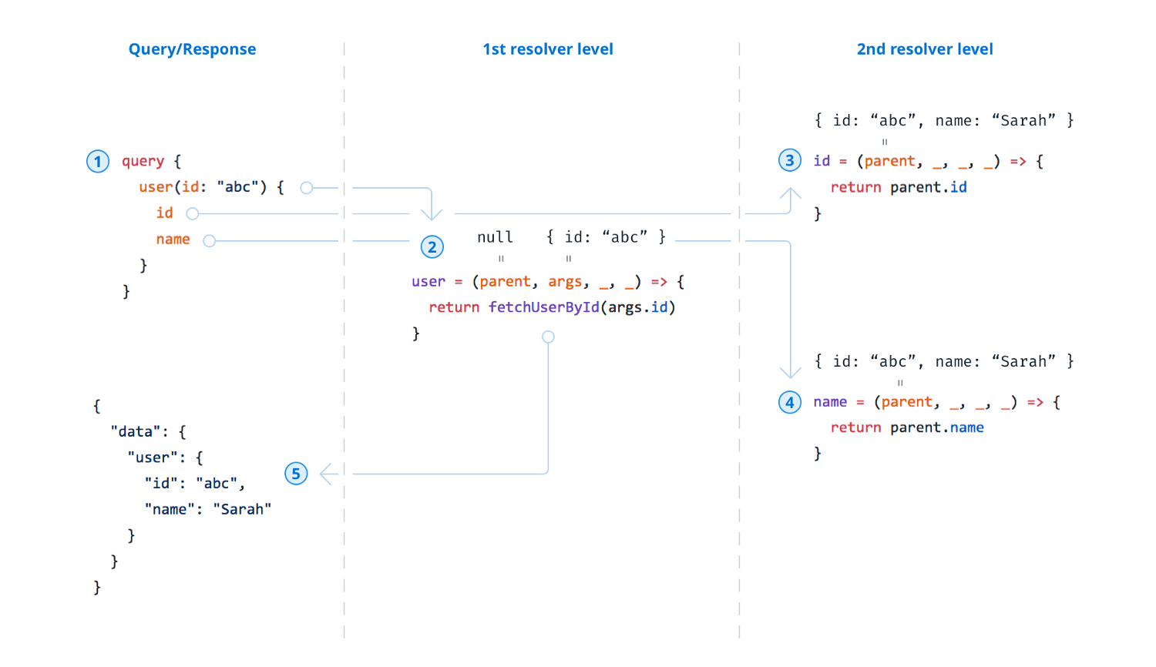
Query Execution

Slide 94
GraphQL Tooling

Slide 95
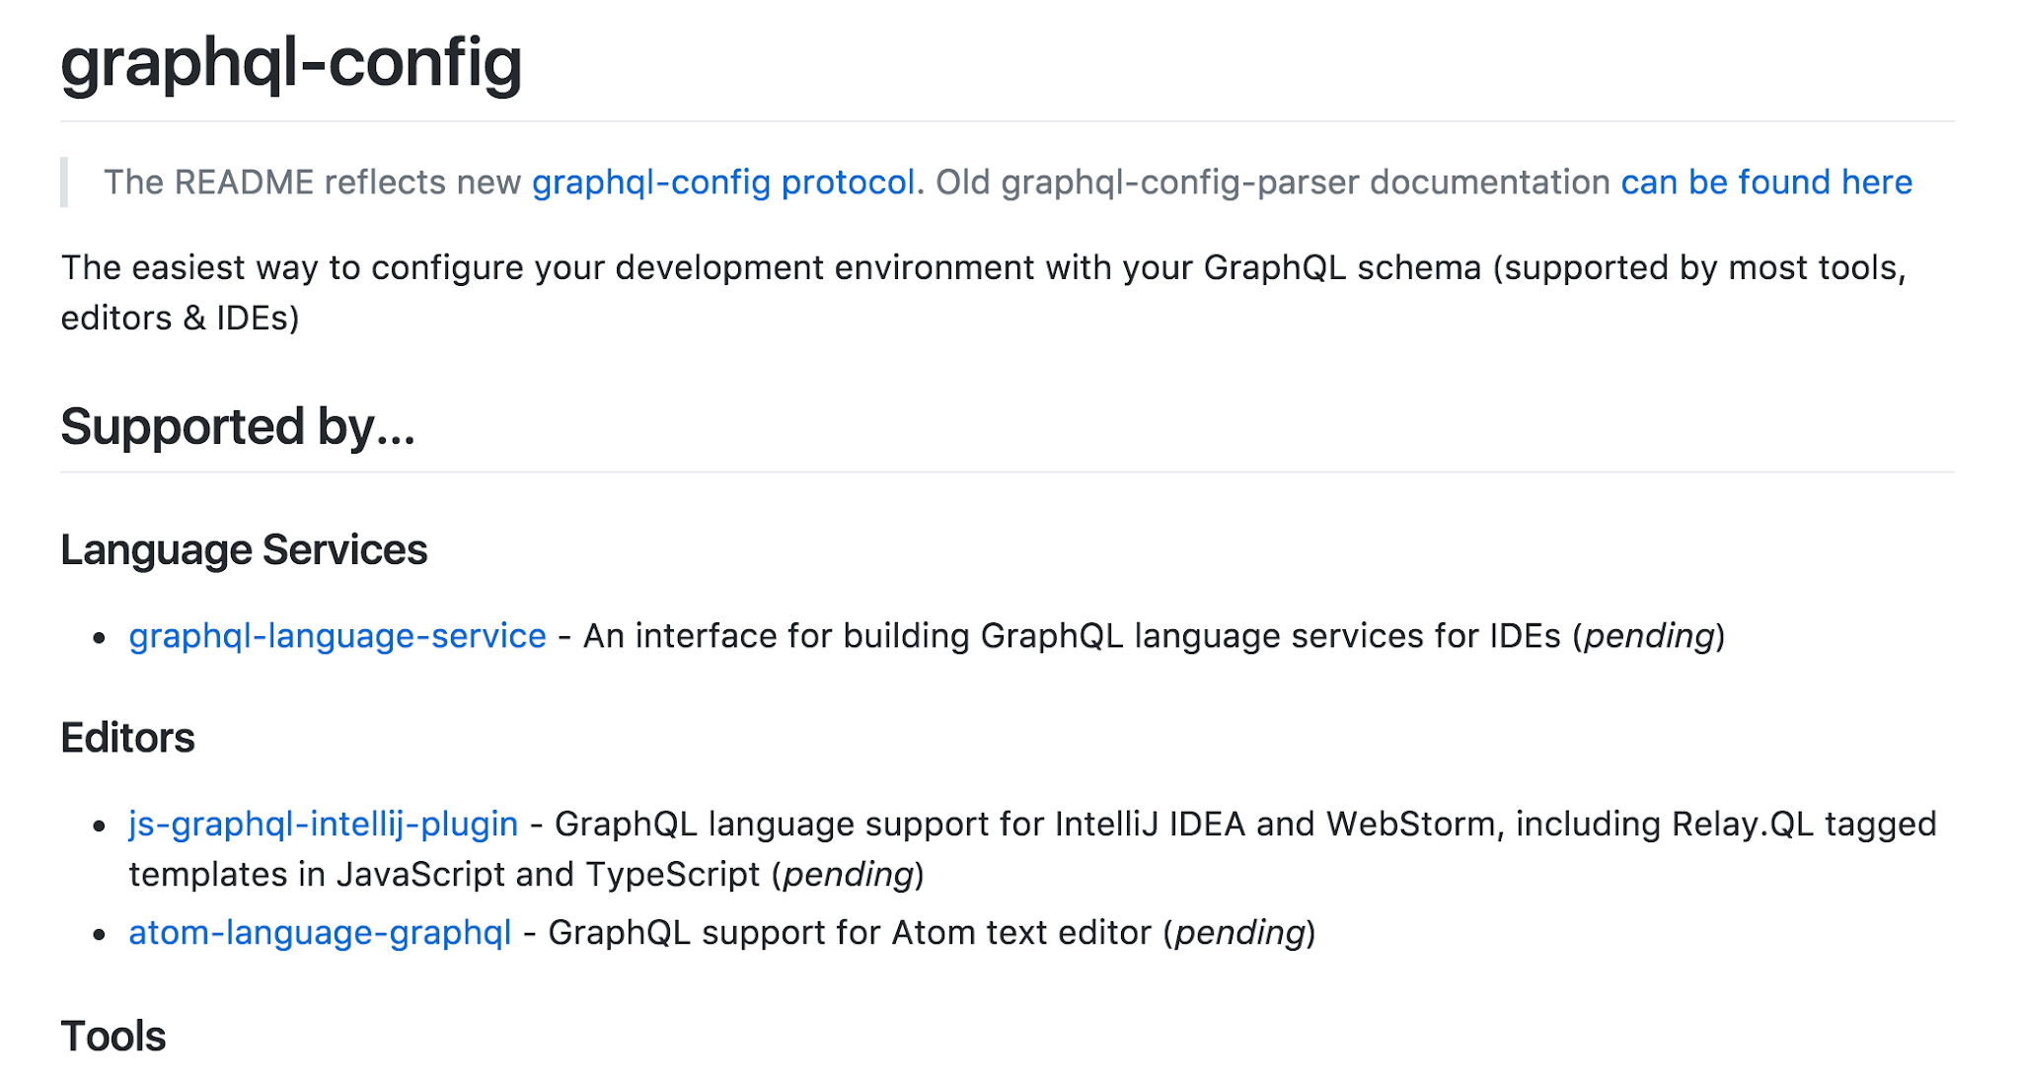
prisma/graphql-config

Slide 96
GraphQL Config
Built by Facebook and graphcool
Broad IDE support
Plugin Architecture

Slide 97
.graphqlconfig
{
"schemaPath": "schema.graphql",
"extensions": {
"endpoints": {
"dev": {
"url": "https://example.com/graphql",
"headers": {
"Authorization": "Bearer ${env:AUTH_TOKEN_ENV}"
},
"subscription": {
"url": "ws://example.com/graphql",
"connectionParams": {
"Token": "${env:YOUR_APP_TOKEN}"
}
}
}
...

Slide 98
Programmatic API
import { getGraphQLConfig } from 'graphql-config'
const config = getGraphQLConfig('./optionalProjectDir')
const schema = config.getConfigForFile(filename).getSchema()
// use schema for your tool/plugin

Slide 99
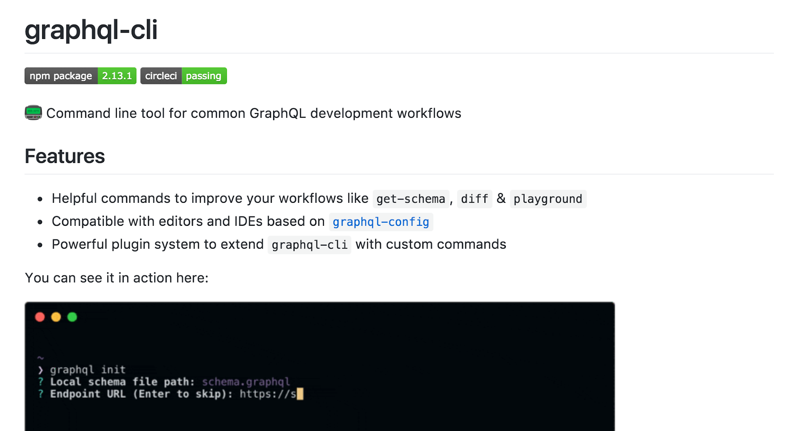
graphql-cli/graphql-cli

Slide 100
GraphQL CLI
Fetch Schema from Server
Diff schemas
Run queries
Create .graphqlconfig
Plugins: voyager, codegen, bindings

Slide 101
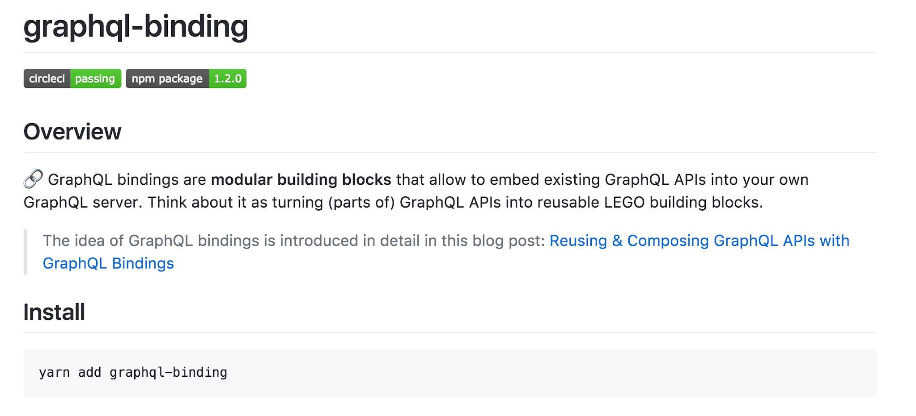
graphql-binding/graphql-binding

Slide 102
graphql-binding
Exposes GraphQL APIs
Allows composition
Type safety (TypeScript)
Static and dynamic bindings

Slide 103
graphql-binding Example
// schema
type Query {
user(id: ID!): User
}
type Mutation {
createUser(): User!
}
// resolvers
findUser(parent, args, context, info) {
return binding.user({ id: args.id }, context, info);
}
newUser(parent, args, context, info) {
return binding.createUser({}, context, info);
}

Slide 104
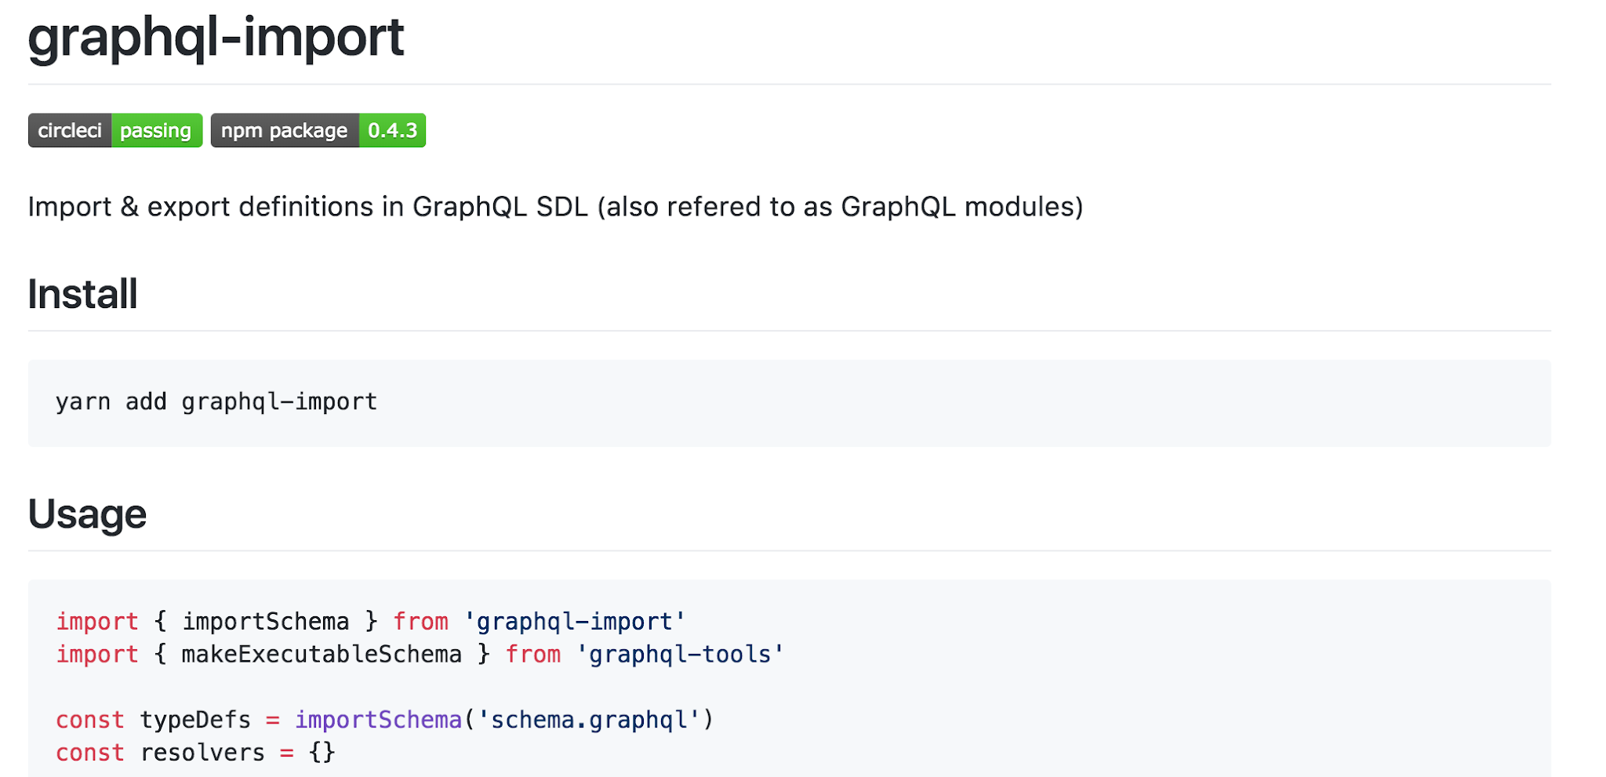
graphcool/graphql-import

Slide 105
graphql-import
Follows Schema Definition Language
Allows Modular Type Definitions
Allows recursive imports
Allows cyclic dependencies

Slide 106
Modular type definitions
// root.graphql
#import Todo from 'todo.graphql'
type MyTodo {
user: String
todos: [Todo]
}
// todo.graphql
type Todo {
id: ID!
text: String!
complete: Boolean!
}

Slide 107
importSchema(file)
console.log(importSchema('root.graphql'))
// output
type MyTodo {
user: String
todos: [Todo]
}
type Todo {
id: ID!
text: String!
complete: Boolean!
}

Slide 108
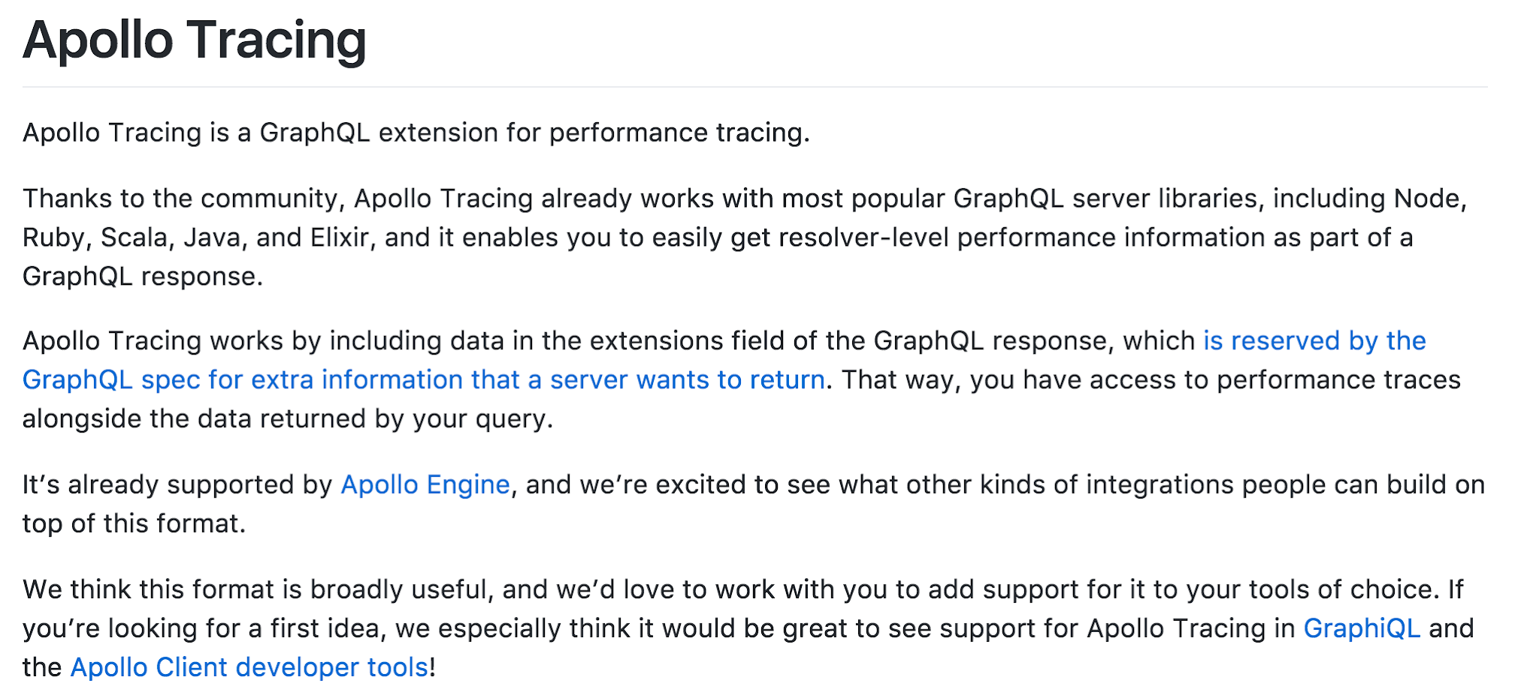
apollographql/apollo-tracing

Slide 109
apollo-tracing
Allows performance tracing
Returns traces in Response
Requires GraphQL Server setup
Supported by GraphQL Playground

Slide 110
apollo-tracing Format
{
"data": <>, "errors": <>,
"extensions": {
"tracing": {
"version": 1, "startTime": <>, "endTime": <>,"duration": <>,
"parsing": { "startOffset": <>, "duration": <> },
"validation": { "startOffset": <>, "duration": <> },
"execution": {
"resolvers": [{
"path": [<>, ...],
"parentType": <>, "fieldName": <>, "returnType": <>,
"startOffset": <>, "duration": <>,
},
...
]
...

Slide 111
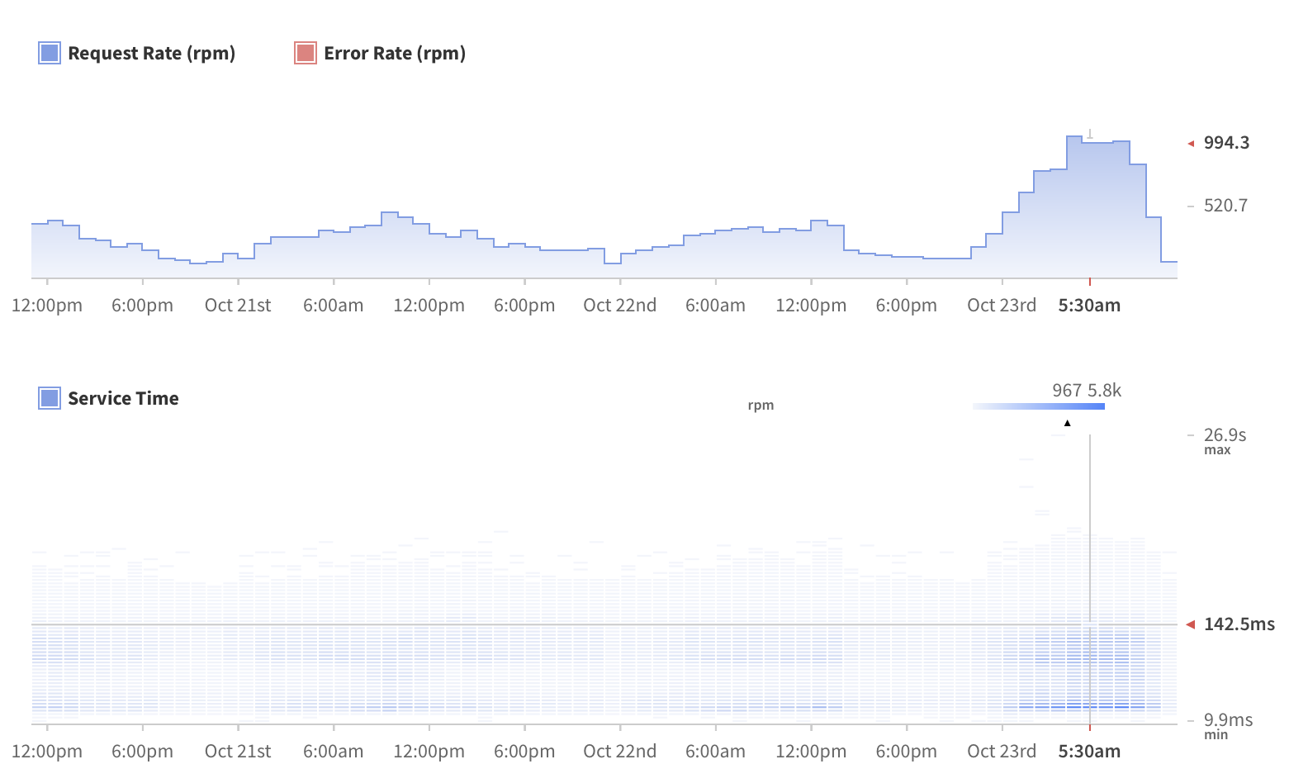
Apollo Engine
Apollo Engine is a cloud service for schema management and performance metrics monitoring

Slide 112
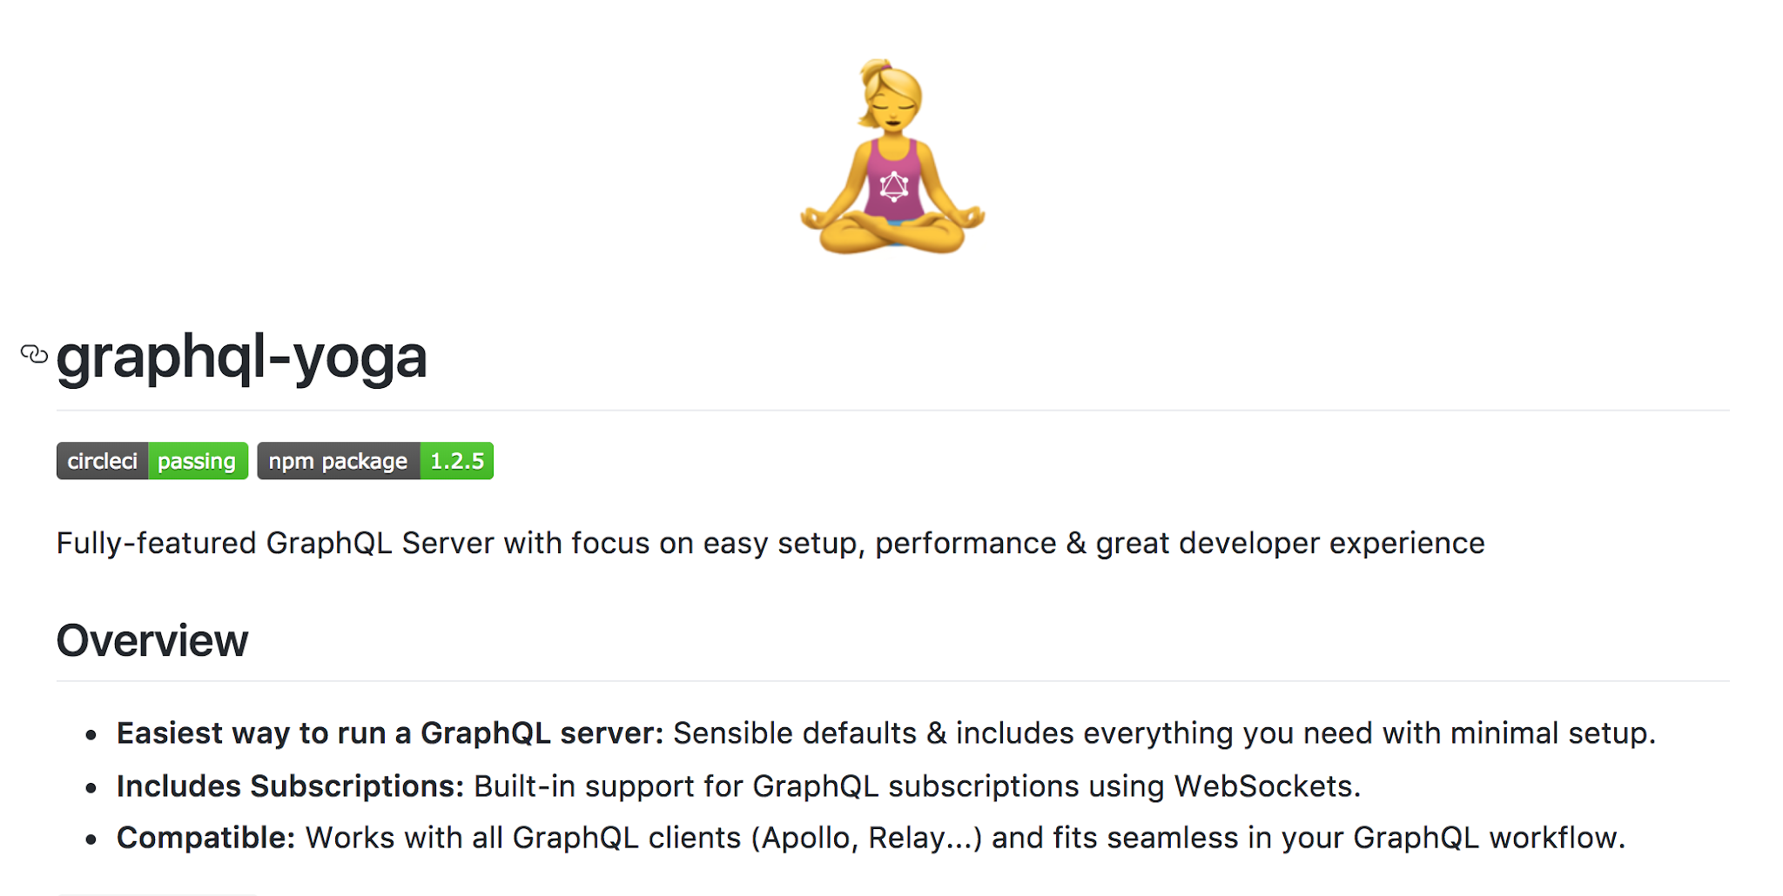
graphcool/graphql-yoga

Slide 113
graphql-yoga
Seed project to create GraphQL Servers
Uses common building blocks​
Minimal setup & best practices

Slide 114
graphql-yoga dependencies
apollo-server
graphql-subscriptions
graphql-tools
graphql-playground

Slide 115
graphql-yoga features
File Upload, Subscriptions
Types (TypeScript), Playground
Apollo tracing
Extensible via Express Middlewares
Accepts application/json/graphql

Slide 117
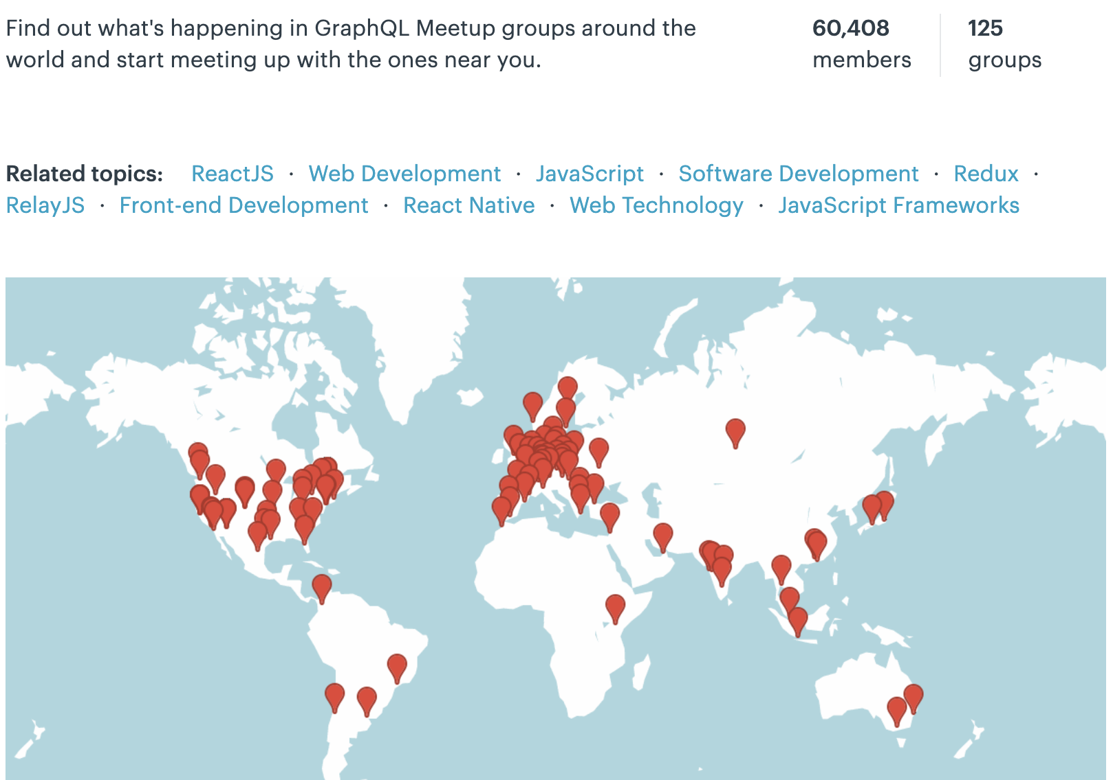
GraphQL Community

